Slide 1

Arlington, VA Housing Data Analysis: Does Proximity to Metro Impact Home Values?
GW Data Bootcamp: Project 1, Team 7

Slide 2

Slide Title
XXXX
Overview and Hypothesis
Central Hypothesis

Slide 3
Data Exploration and Cleaning
XXXX
Data Cleaning

Slide 4
Data Analysis
XXXX
Data Analysis

Slide 5
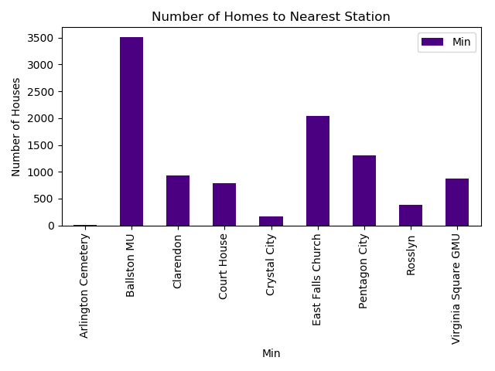
Findings (1/?)
XXXX
Findings: XXXX

Slide 6
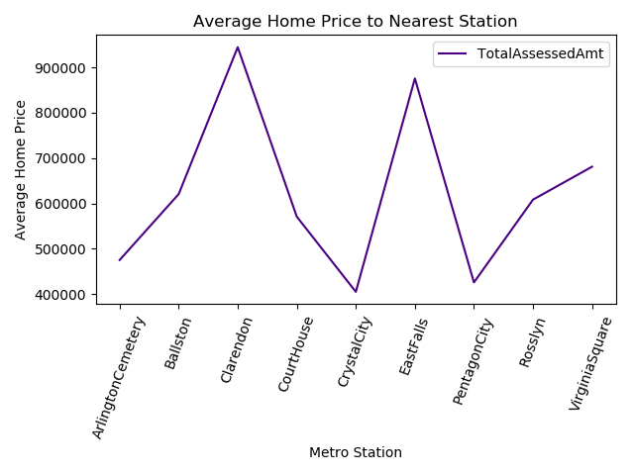
Findings (2/?)
XXXX
Findings: XXXX

Slide 7
Conclusion & Implications
XXXX
Ballston had the most homes near their station
The most expensive area to live in Arlington is near the Clarendon station
Homes near the Crystal City station have the cheapest homes (for now; Hello Amazon!)
Conclusion

